Slide 1

SERVICES & DEPENDENCY INJECTION

Slide 2
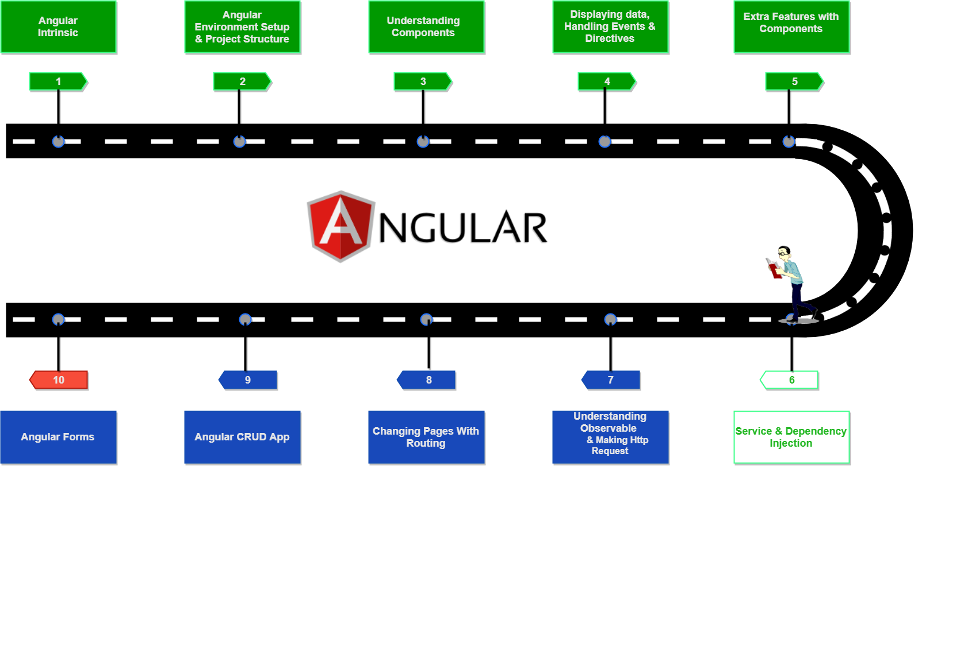
Angular RoadMap

Slide 3

Contents
What is Service
What is Dependancy Injection
How does Services and Dependancies works
Building Service
Registering service
Inject Service

Slide 4

What is Service
Service is the class with a focused purpose
An angular service is simply a function that allows you to access its' defined properties and methods. It also helps keep your coding organized.
Minimise number of line of code ( Code Reusability )

Slide 5
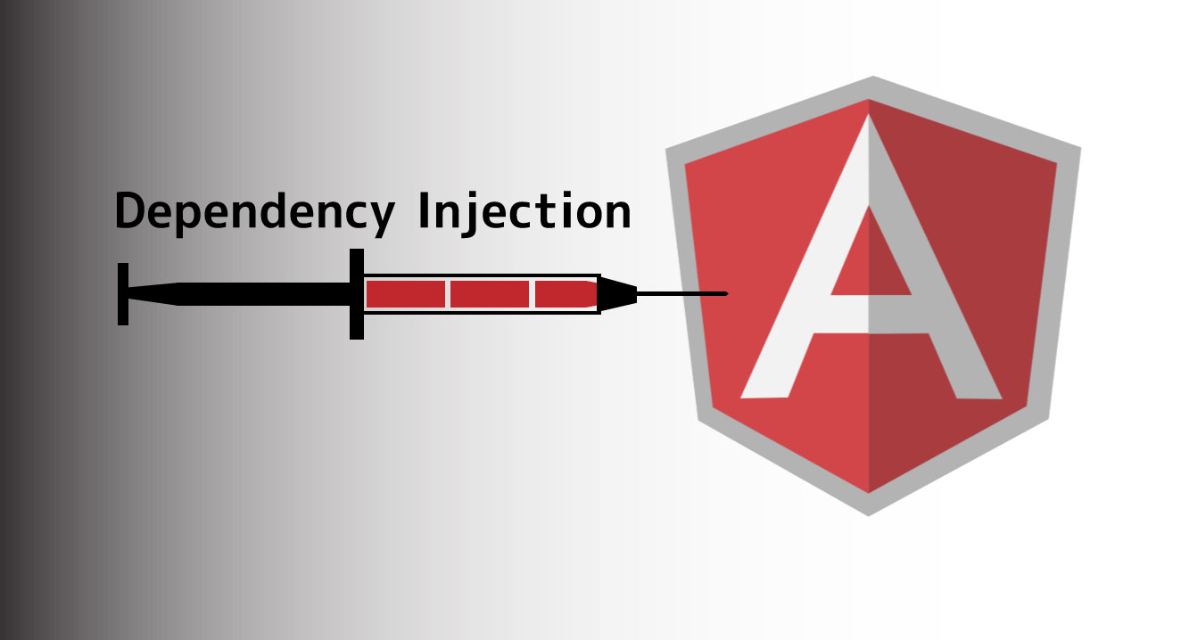
What is Dependancy Injection
Dependency Injection(DI) is a technique in which we provide an instance of an object to another objectm which depends on it.
Dependency injection pattern made our Componen reusable,Testable, Maintainable etc.
Dependency injection is the ability to add the functionality of components at runtime.

Slide 6
How does Services & Dependancies works
step : 1 Building Service
step : 2 Register Service
step : 3 Inject the Service

Slide 7
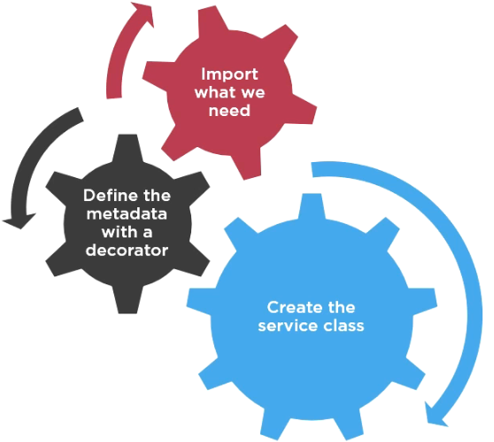
Building Service

Slide 8
...
Create file for Service
name.service.ts
Import the Injectable Member
import { Injectable } from '@angular/core';
Add the Injectable Decorator
Export the Services Class

Slide 9
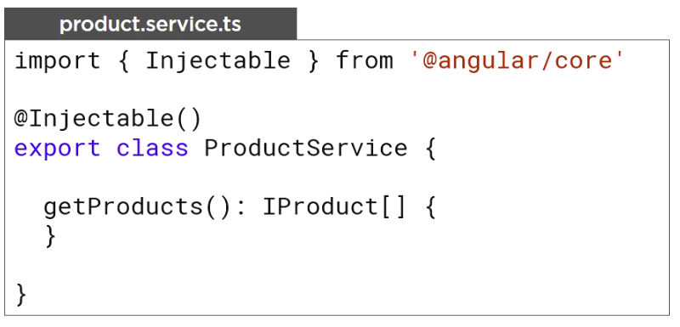
...

Slide 10


Registering service
In order to register a service with Angular you use the provider's property.
provider is code that can create or return a service
Typically the service class itself
For registering a provider
Define in component OR Angular module metadata.

Slide 11
...
Registering in component
if we register in Angular component metadata the angular injector can inject this service into the component and its children.
Registering in Angular module
if we register in Angular module then the service is register at the applications root. making the service available everywhere within this application

Slide 12
Inject Service
In Angular we do Dependency injection inside a constructor.
every class has a constuctor that is executed when an instance of the class is created.
constructor(private _exampleService:ExampleService)
{
}

Slide 13


Slide 14


